Slide 1
Diverse effects of locomotion and arousal on inhibitory and excitatory neurons in auditory cortex
Final Oral Defense
Iryna Yavorska
09.20.2019

Slide 2
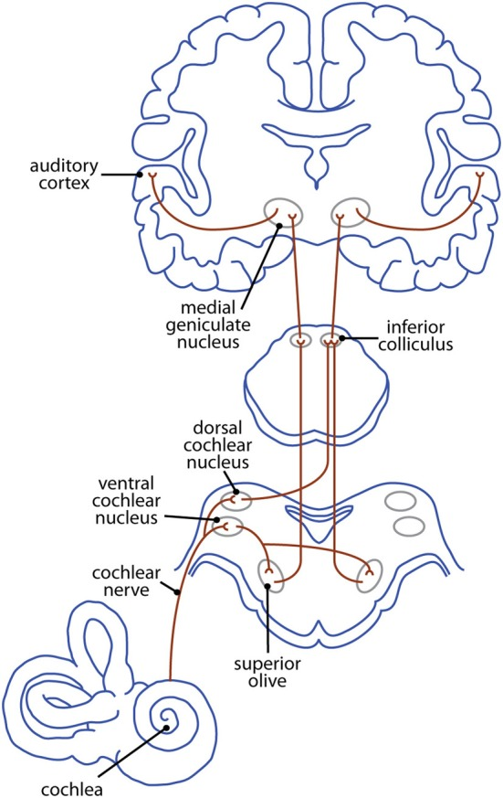
Mammalian Auditory Pathway
Butler & Lomber, 2013
Notes:
The great journey that the sound travels before it reaches auditory cortex
Processed in 5-6 structures before it gets to auditory cortex
Auditory cortex is not necessary for hearing unlike visual visual cortex
The contribution of auditory cortex to sounds processing is not clear but my looking at its structure we can start deducing it

Slide 3
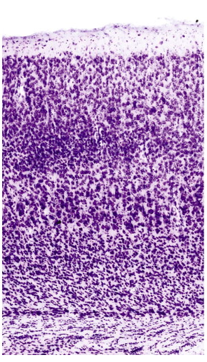
Cortical Circuits
Cortico-cortical modulation
Layer 1
Layer 2/3
Integration and processing of sensory information
Layer 4
Thalamocortical input
Layer 5
Cortical output
Layer 6
Nissl stain of the cortical layers in a mouse (Dr. Erika Gyengesi)
Notes:
Sound comes in to layer 4 – layer 2/3 - layer 4 – layer 5 + 6
Auditory information is sent to other regions for
decision making, learning, memory formation, motor planning and so on.
RECENT STUDIES HAVE SHOWN that AUDITORY CORTEX RECEIVES A LOT OF MODULATORY INPUT suggesting that one of its roles is to integrate sensory information with information about the internal state of the animal.
Neurons show remarkable diversity in shapes, sizes, connections

Slide 4
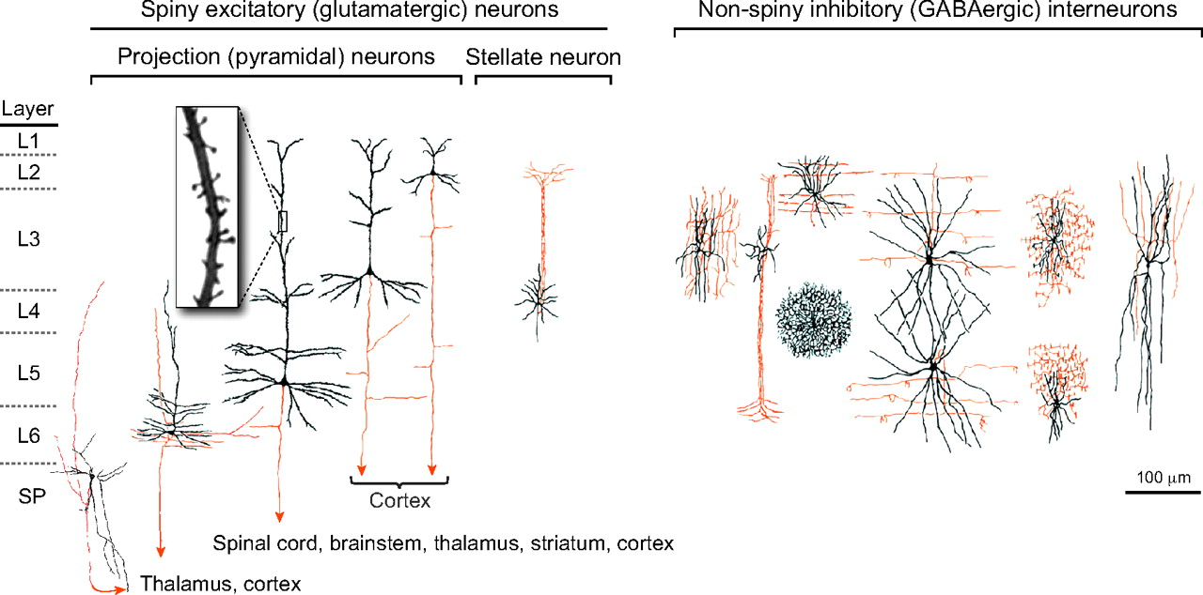
Diversity of Neuronal Subtypes
Excitatory neurons (80%)
Inhibitory interneurons (20%)
Shefi et al, 2004
Notes:
80% excitatory and 20 inhibitory
how many there are? why are there so many?
the inhibitory interneurons can be classified in3 different groups base don their molecular markers

Slide 5
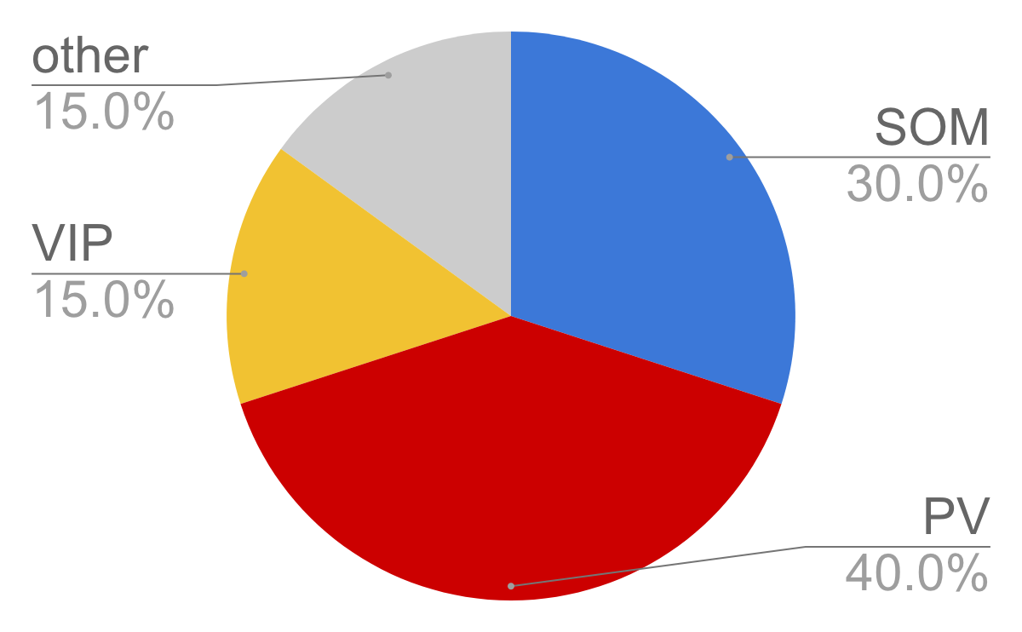
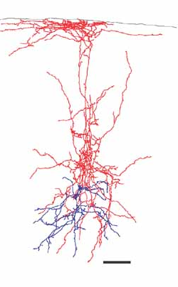
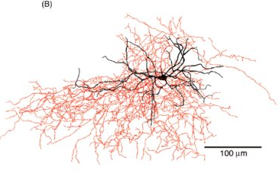
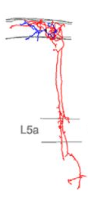
Inhibitory Interneurons Subtypes
Parvalbumin
(PV, fast-spiking)
Somatostatin
(SOM, low-threshold spiking)
Vasopressin intestinal peptide (VIP)
Rudy et al, 2011
Notes:
PV – fast-spiking – fast decaying inhibition
SOM – low-threshold spiking – slow delayed inhibition
VIP – are interesting because of their connectivity to other neurons in the circuit

Slide 6

Modulation of Auditory Cortical Neurons
VTA & SN
(DA)
Locus coeruleus
(NE)
Basal forebrain
(ACh)
Motor cortex
(Glu)
Raphe Nuclei
(5-HT)
Reinforcement
VIP
Locomotion
Task engagement
Arousal
PV
SOM
Exc
glia
Notes:
this disinhibition is unique to VIP
what are the behaviors that can modulate this circuit?
what are the modulatory mechanisms?
There are different behaviors that can modulate cortical circuit and different systems can be involved

Slide 7
Modulation of Auditory Cortical Neurons
Locus coeruleus
(NE)
Basal forebrain
(ACh)
Motor cortex
(Glu)
VIP
Locomotion
Arousal
PV
SOM
Exc
glia

Slide 8
Modulation of Auditory Cortical Neurons
Locus coeruleus
(NE)
Basal forebrain
(ACh)
Motor cortex
(Glu)
VIP
Locomotion
Arousal
PV
SOM
Exc

Slide 9
Modulation of Auditory Cortical Neurons
Basal forebrain
(ACh)
Motor cortex
(Glu)
VIP
Locomotion
Arousal
PV
SOM
Exc

Slide 10
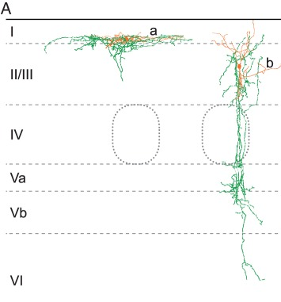
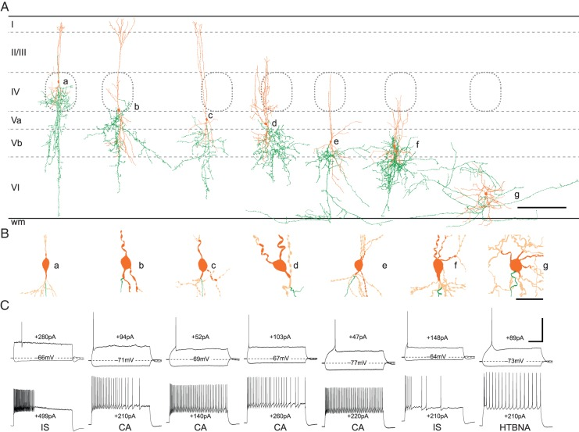
VIP Interneurons in Cortical Circuits
Cortico-cortical modulation
dendrites
Integration and processing of sensory information
Thalamocortical input
axons
Cortical output
Prönneke et al, 2015
L6 L5 L4 L2/3 L1
Notes:
Judging from the morphology of VIP, they are the likely culprit of modulatory circuit

Slide 11
Hypothesis
Basal forebrain
(ACh)
Motor cortex
(Glu)
VIP
Locomotion
Arousal
PV
SOM
Exc
Notes:
Locomotion and arousal modulate cortical circuit via activity of VIP neurons, resulting in some disinhibitory and inhibitory effects.
VIP neurons are small and hard to record from

Slide 12
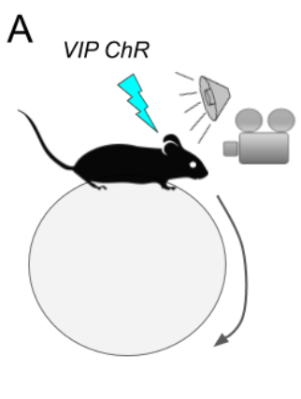
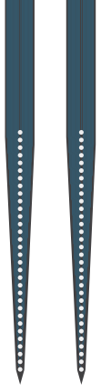
Experimental Design
time
laser
white noise
(80 dB)
-50 0 600 750
time (ms)
800 𝝻m
laser
silence
-50 0 600 750
time (ms)
Notes:
Activating VIP cells using ChR opsin, measuring running with ball motion and arousal by pupil size while presenting auditory stimuli
For auditory stimuli, I used white noise because it activates all neurons broadly
Linear silicon probe allowed me to record from neurons in most cortical layers

Slide 13
Outline
Behavioral state change
Effects of behavioral state change on neural activity
VIP
Effects of VIP activation on neural activity
SOM
PV
Interaction between behavioral and VIP modulation of neural activity
Exc
Notes:
First- effects of behavioral state change
Second – effects of VIP activation on the activity
Then test whether the behavioral state change is mediated by VIP by testing the interaction of two effects

Slide 14
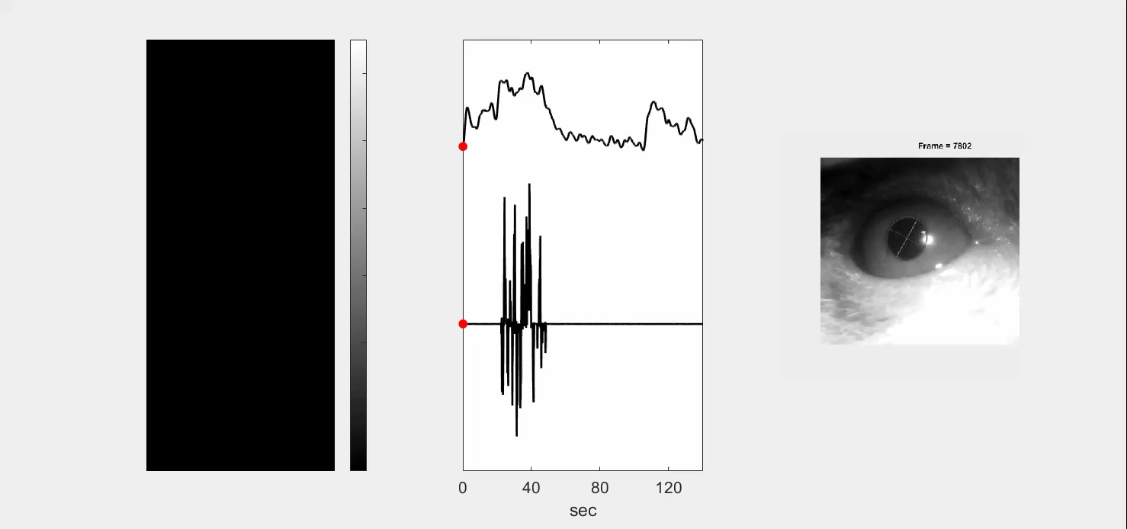
Auditory Neurons Are Modulated by Behavioral State
pupil
Normalized FR - 41 neurons
running
eye
800 ms
Notes:
video that this set u allows me to collect
neurons

Slide 15
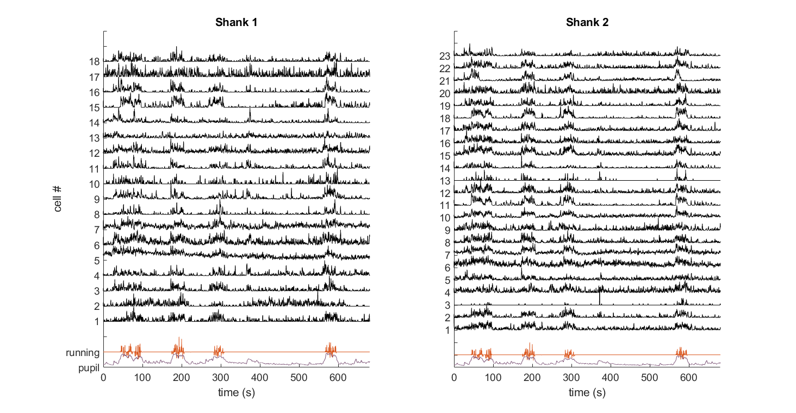
Auditory Neurons Are Modulated by Behavioral State
Notes:
Most of our knowledge about the activity of the auditory neurons comes from years of research in anesthetized animals, it’s only recently that we have been able to record form single neurons in awake animals

Slide 16
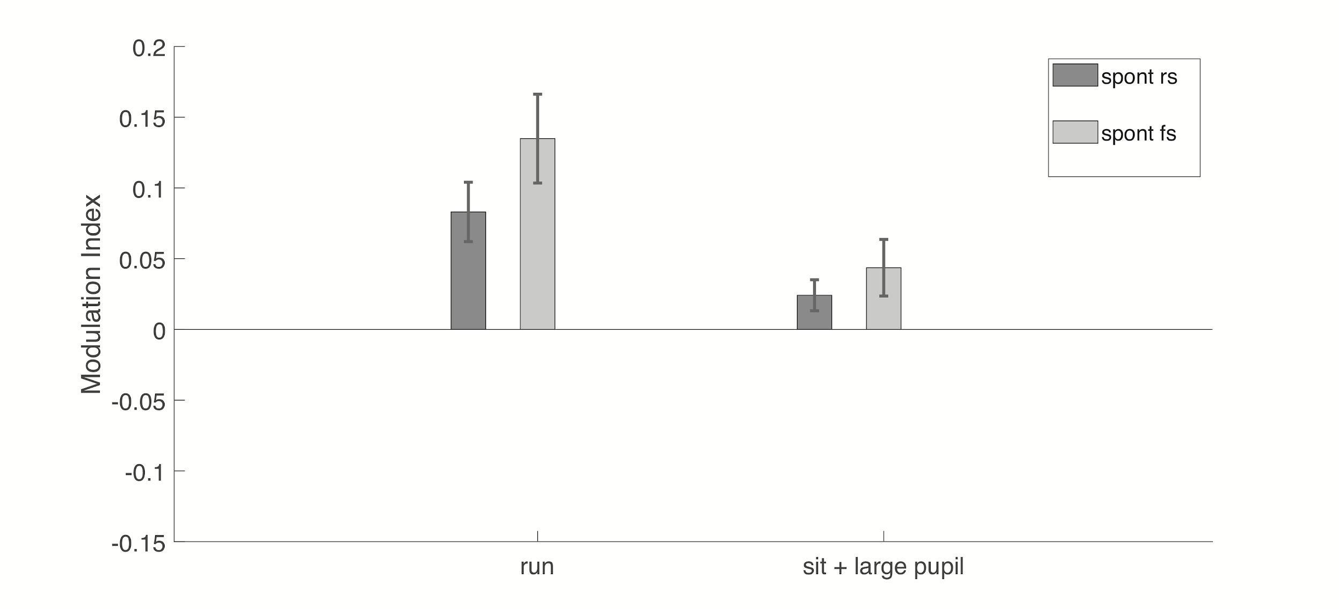
Modulation of spontaneous activity
Modulation Index = (FR state A - FR state B) / (FR state A + FR state B)
regular spiking
fast spiking
Notes:
Spend some time on this slide
For running modulation index means – running vs sitting trials
For arousal modulation means – large vs small pupil trials, all stationary

Slide 17
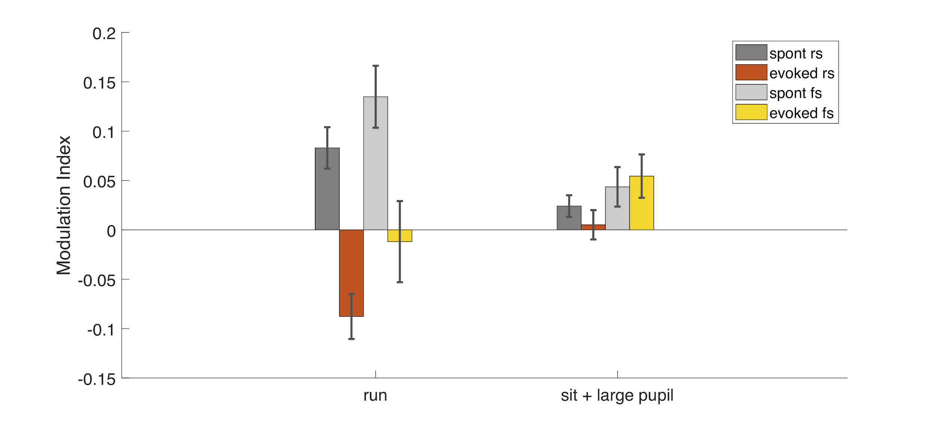
Modulation of evoked activity
*
*
regular spiking
fast spiking
*
*
*
*
Running rs = 283, 203; fs = 71, 53; n recs =11; Sit+large pupil rs = 335, 348; fs = 96, 78; n recs = 17
Notes:
effects are small but significant
lets look at the layer effects

Slide 18
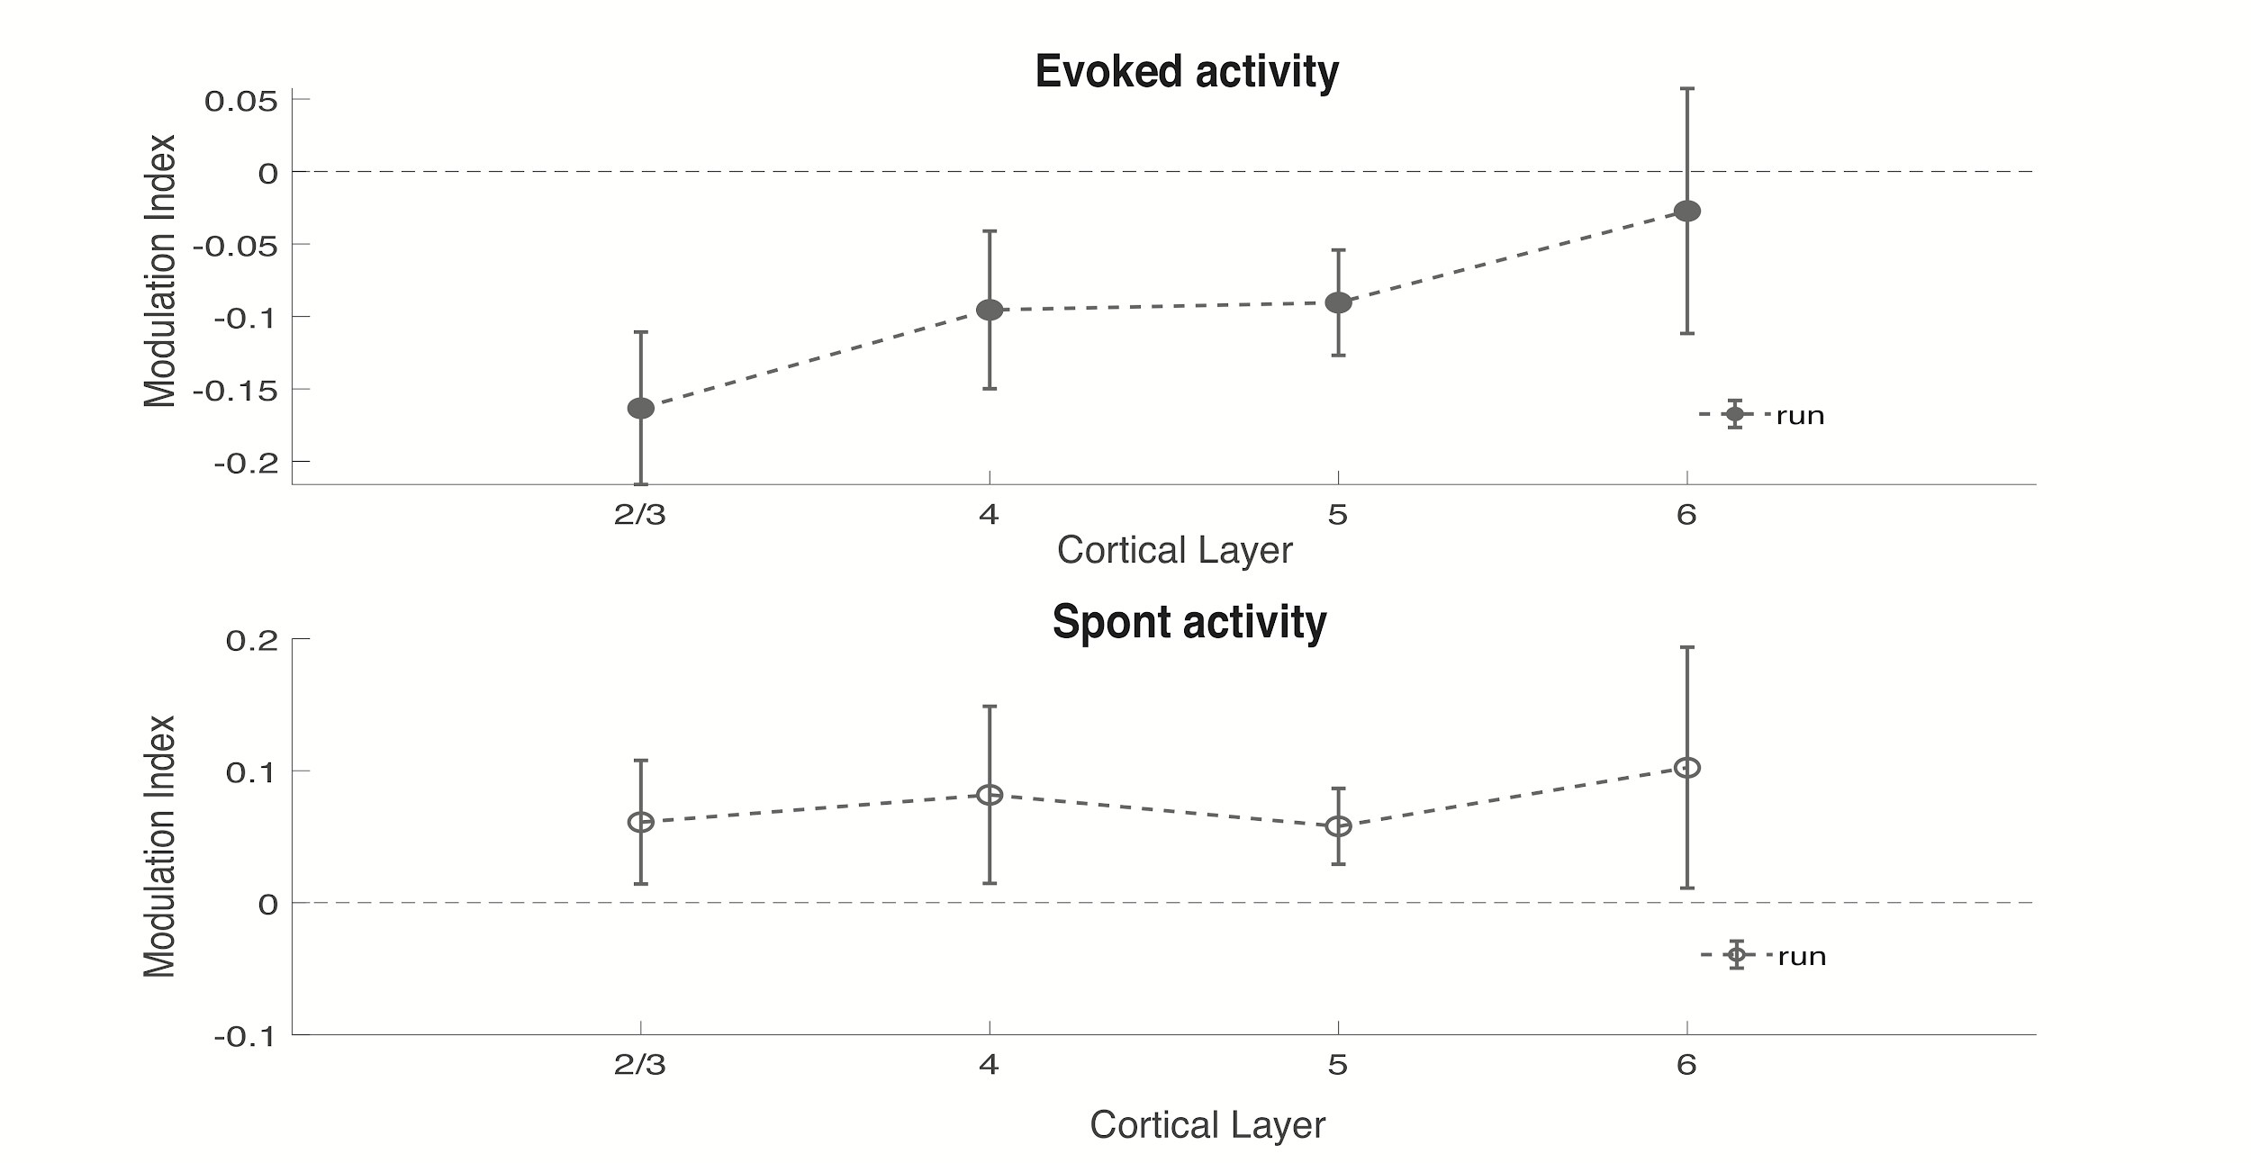
Modulation across cortical layers
evoked : n = 23, 20, 50, 15; spontaneous: n =32, 42, 85, 23
Notes:
All cells, SEM

Slide 19
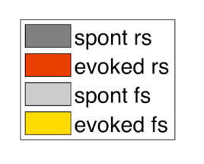
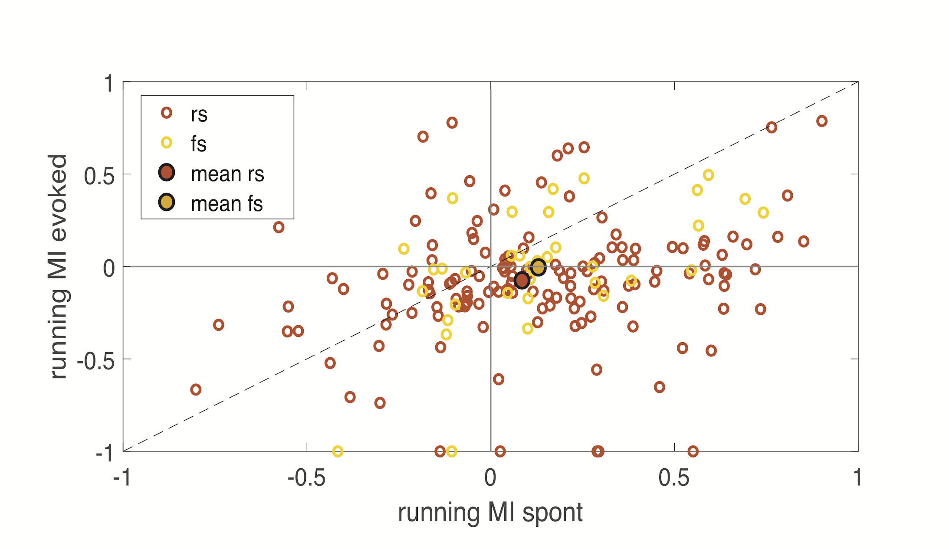
Modulation - running
*
*
*
Notes:
legends

Slide 20
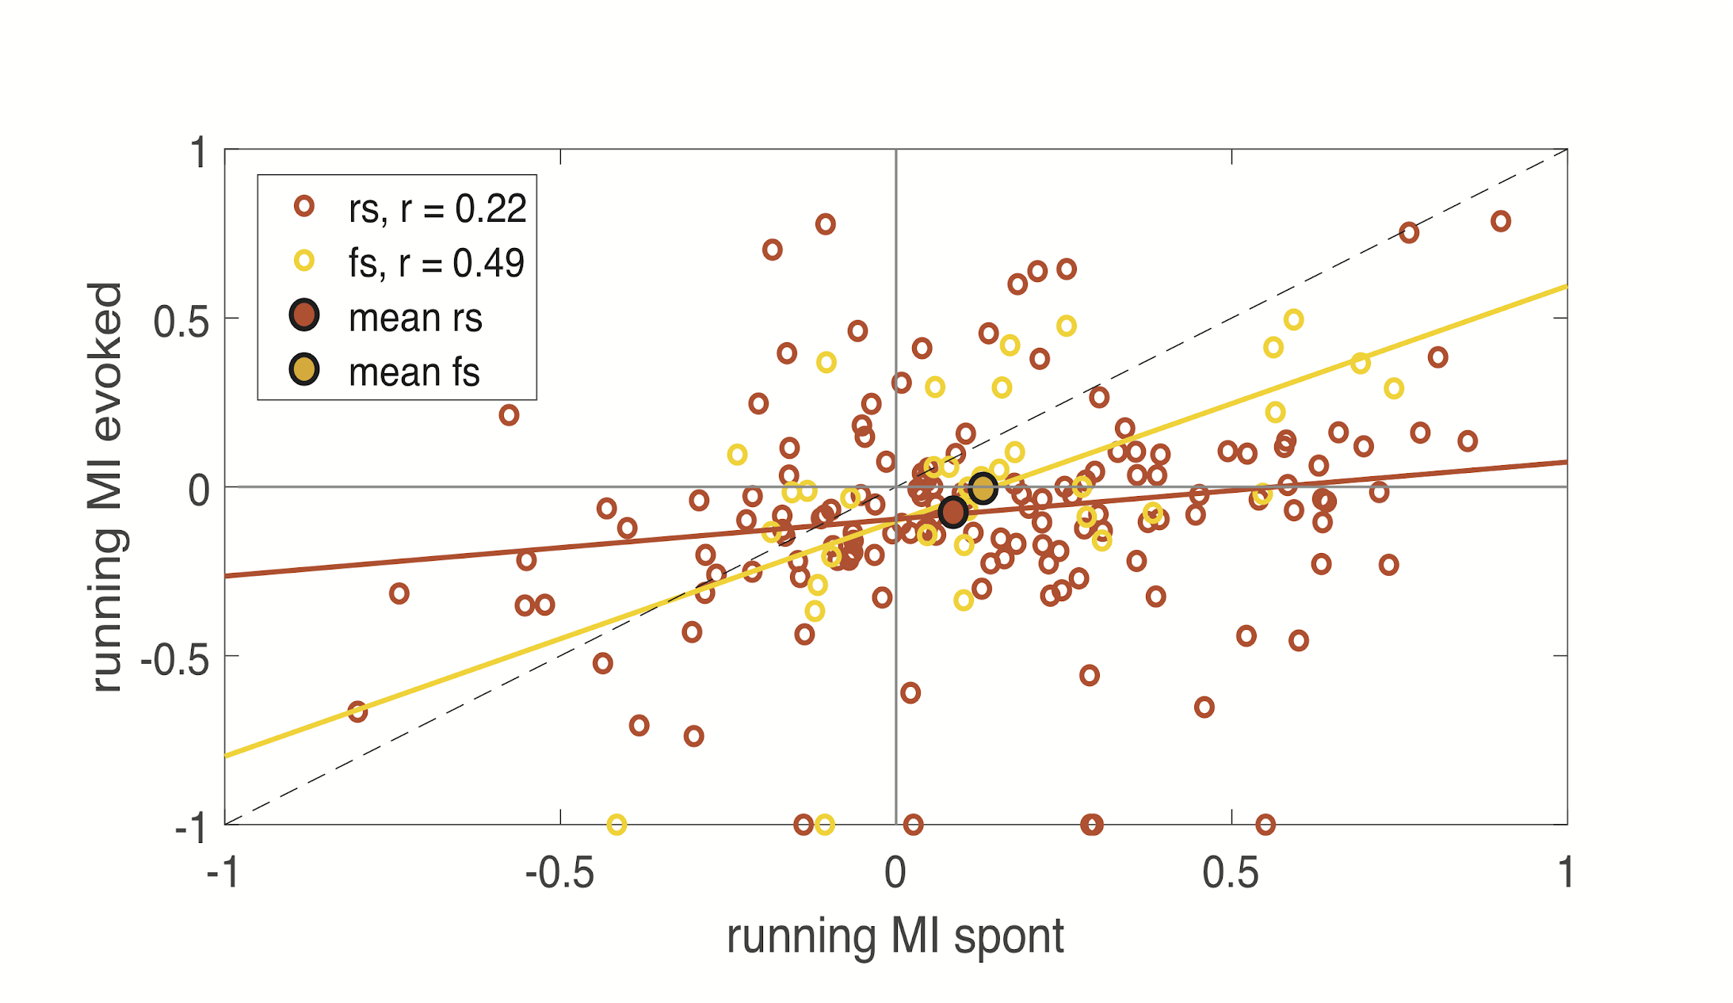
Modulation - running
*
*
y= -0.12 +0.61x
y= -0.12 +0.28x
*
Notes:
though means are significant, they do not show the full picture

Slide 21
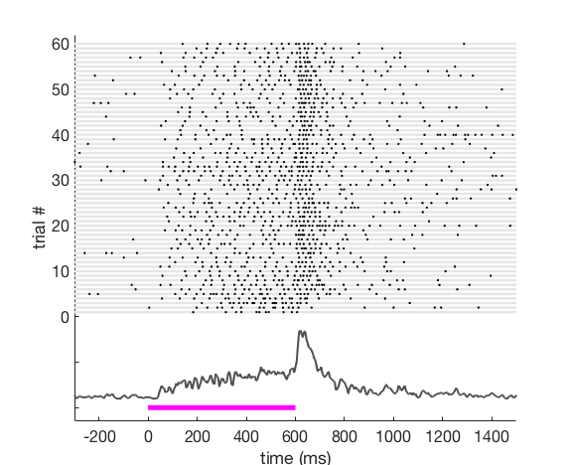
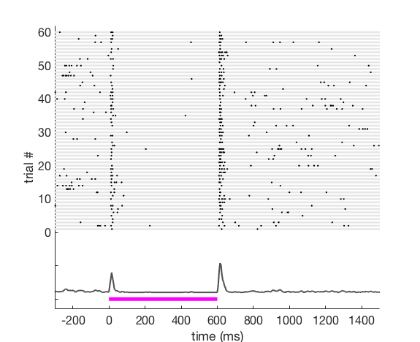
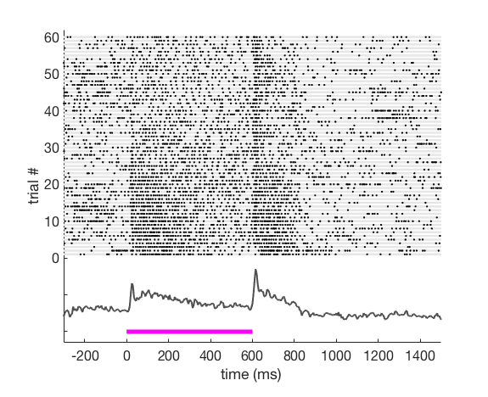
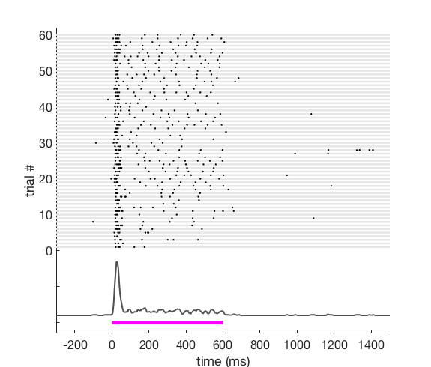
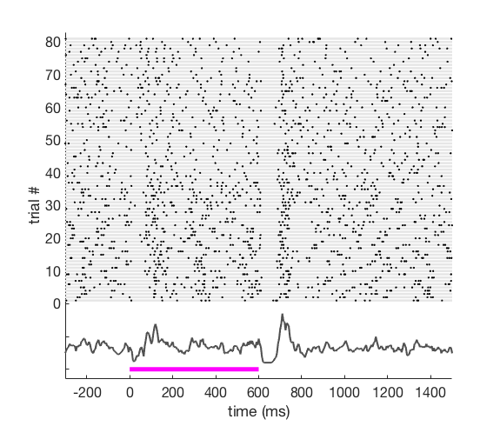
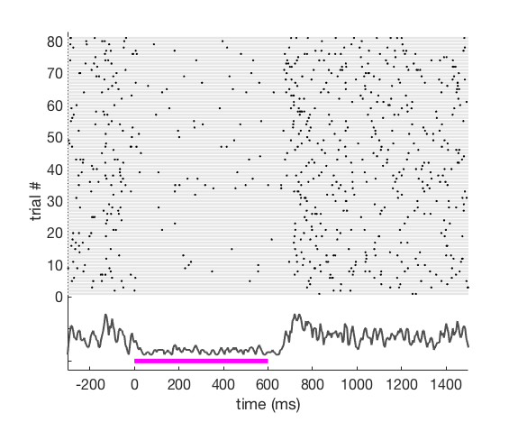
Types of responses - white noise burst
Notes:
Spend some time on this slide

Slide 22
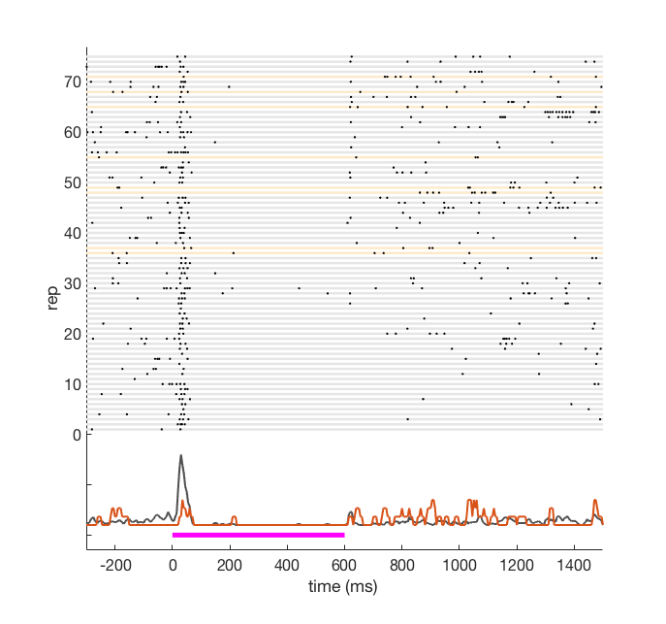
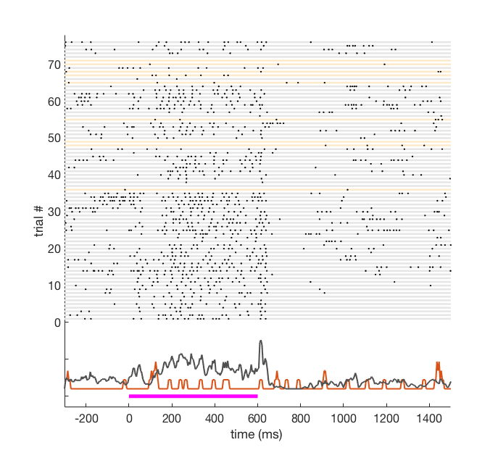
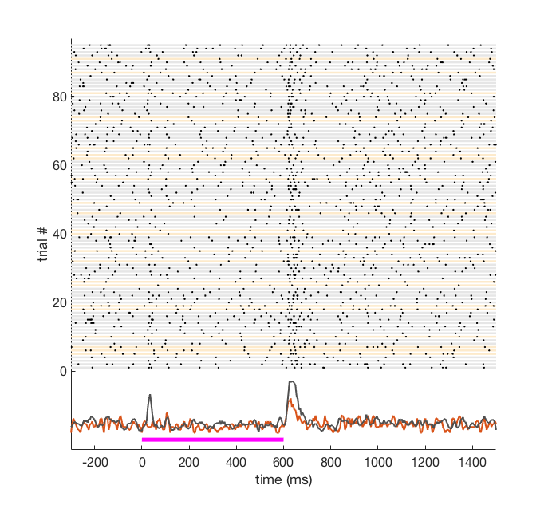
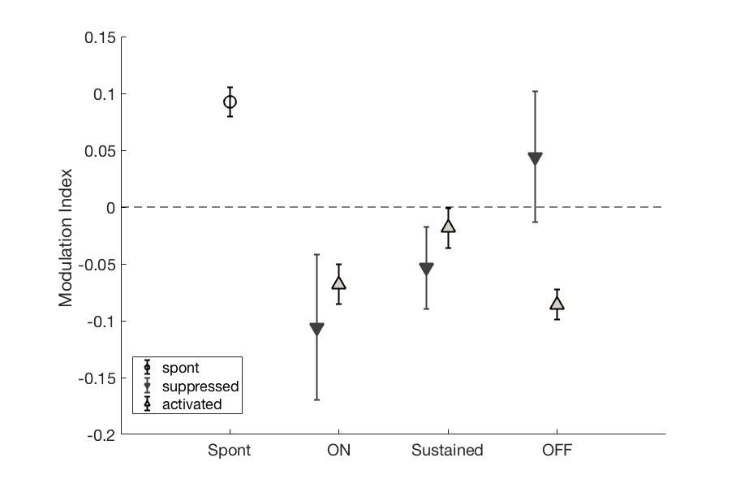
Types of responses - running
Sustained
OFF
ON
Notes:
spont - reference
activated - upward arrow
suppressed - downward error

Slide 23
Behavioral modulation - Summary
Effects of running on auditory neurons are diverse and distributed without cellular specialization
Overall, running increases spontaneous activity and suppresses evoked responses - reducing Signal-to-Noise ratio
Running modulates all types of evoked responses

Slide 24
Outline
Effects of behavioral state change on neural activity
VIP
Effects of VIP activation on neural activity
SOM
PV
Interaction between behavioral and VIP modulation of neural activity
Exc

Slide 25
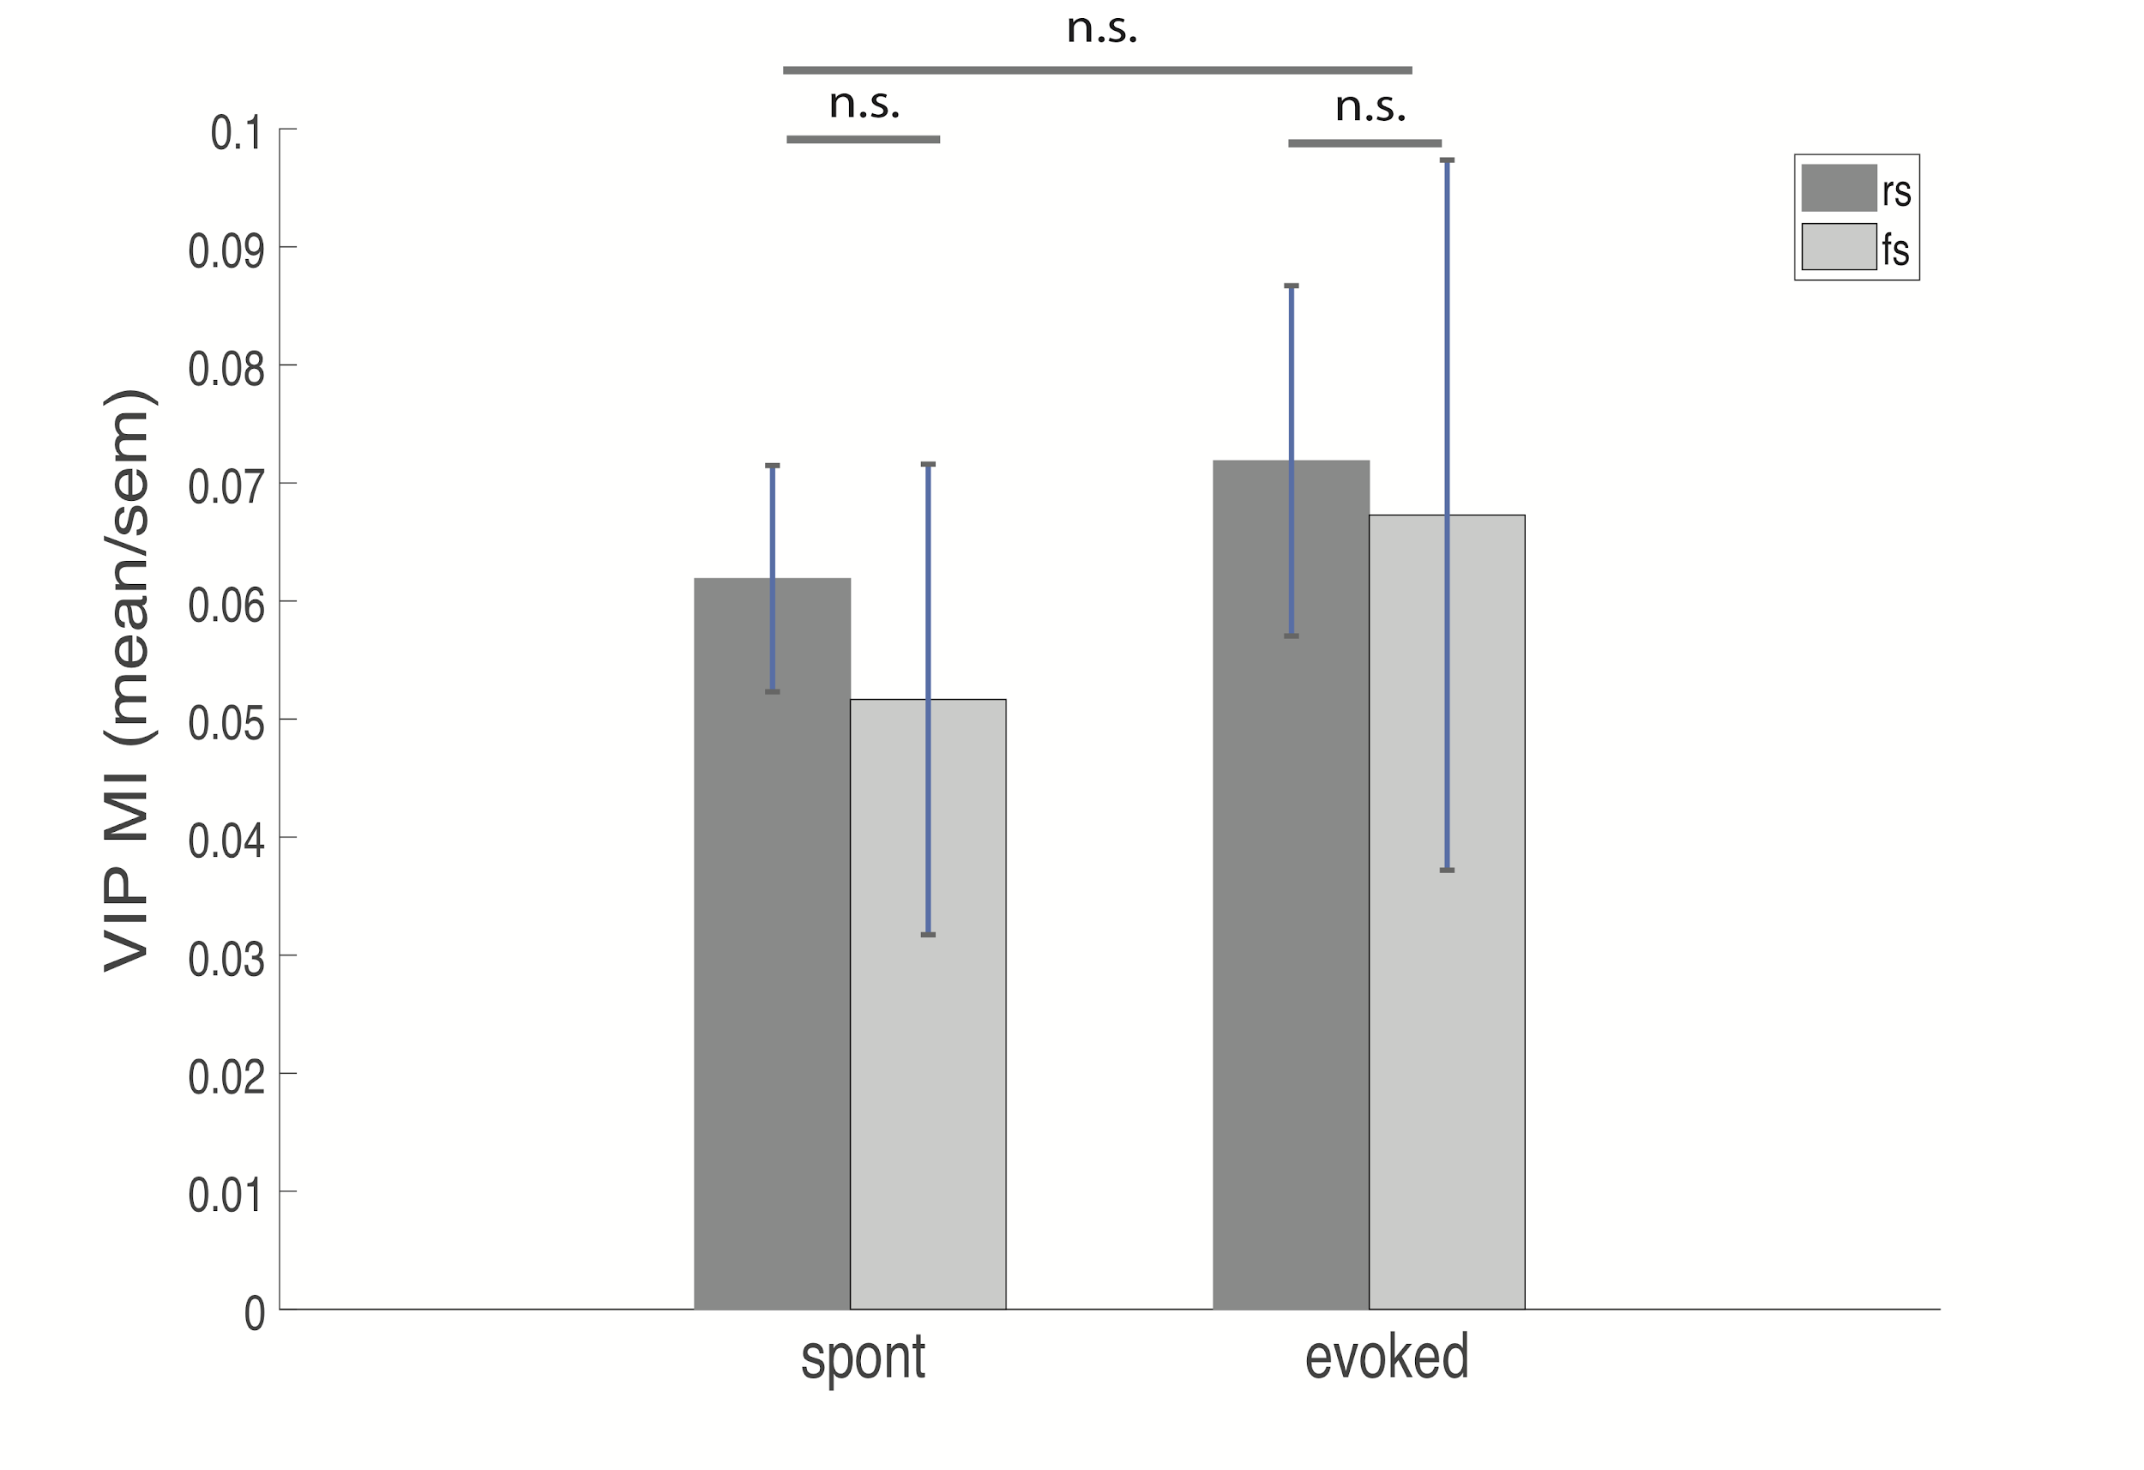
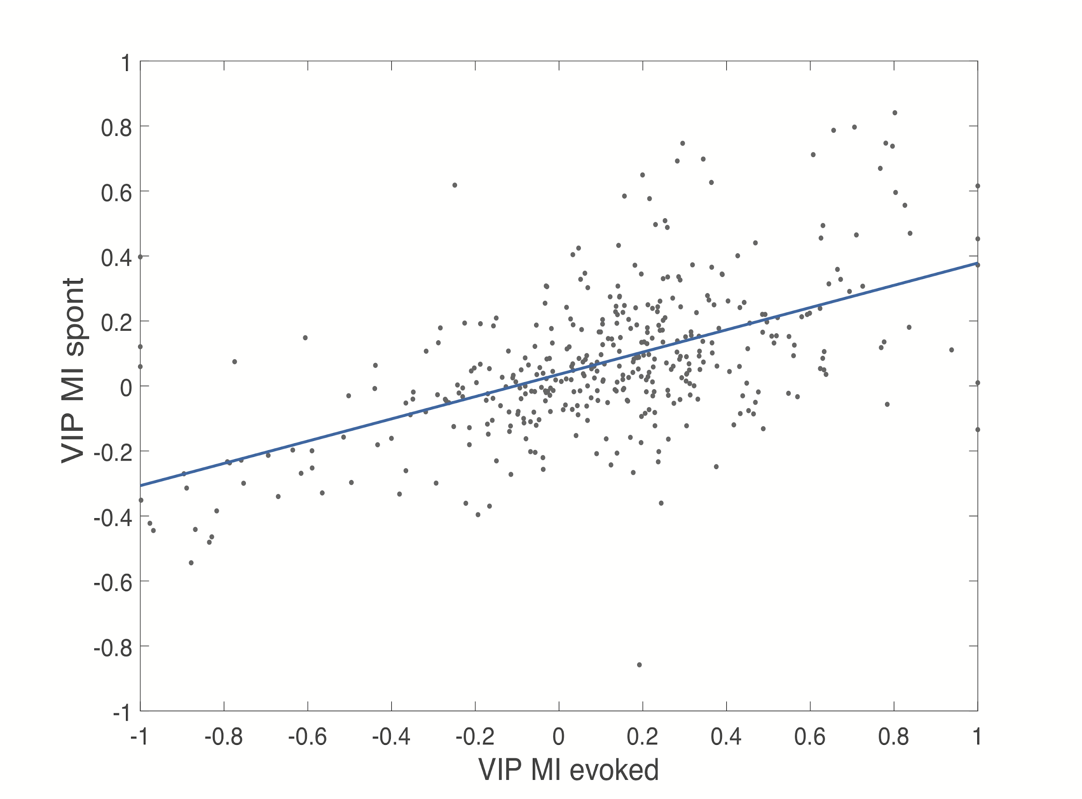
VIP activation
y = 0.04 + 0.34x
rho = 0.51, p = 1.08e-28
Notes:
as expected, both spontaneous and evoked activity increase
similarly to running this effect is correlated

Slide 26
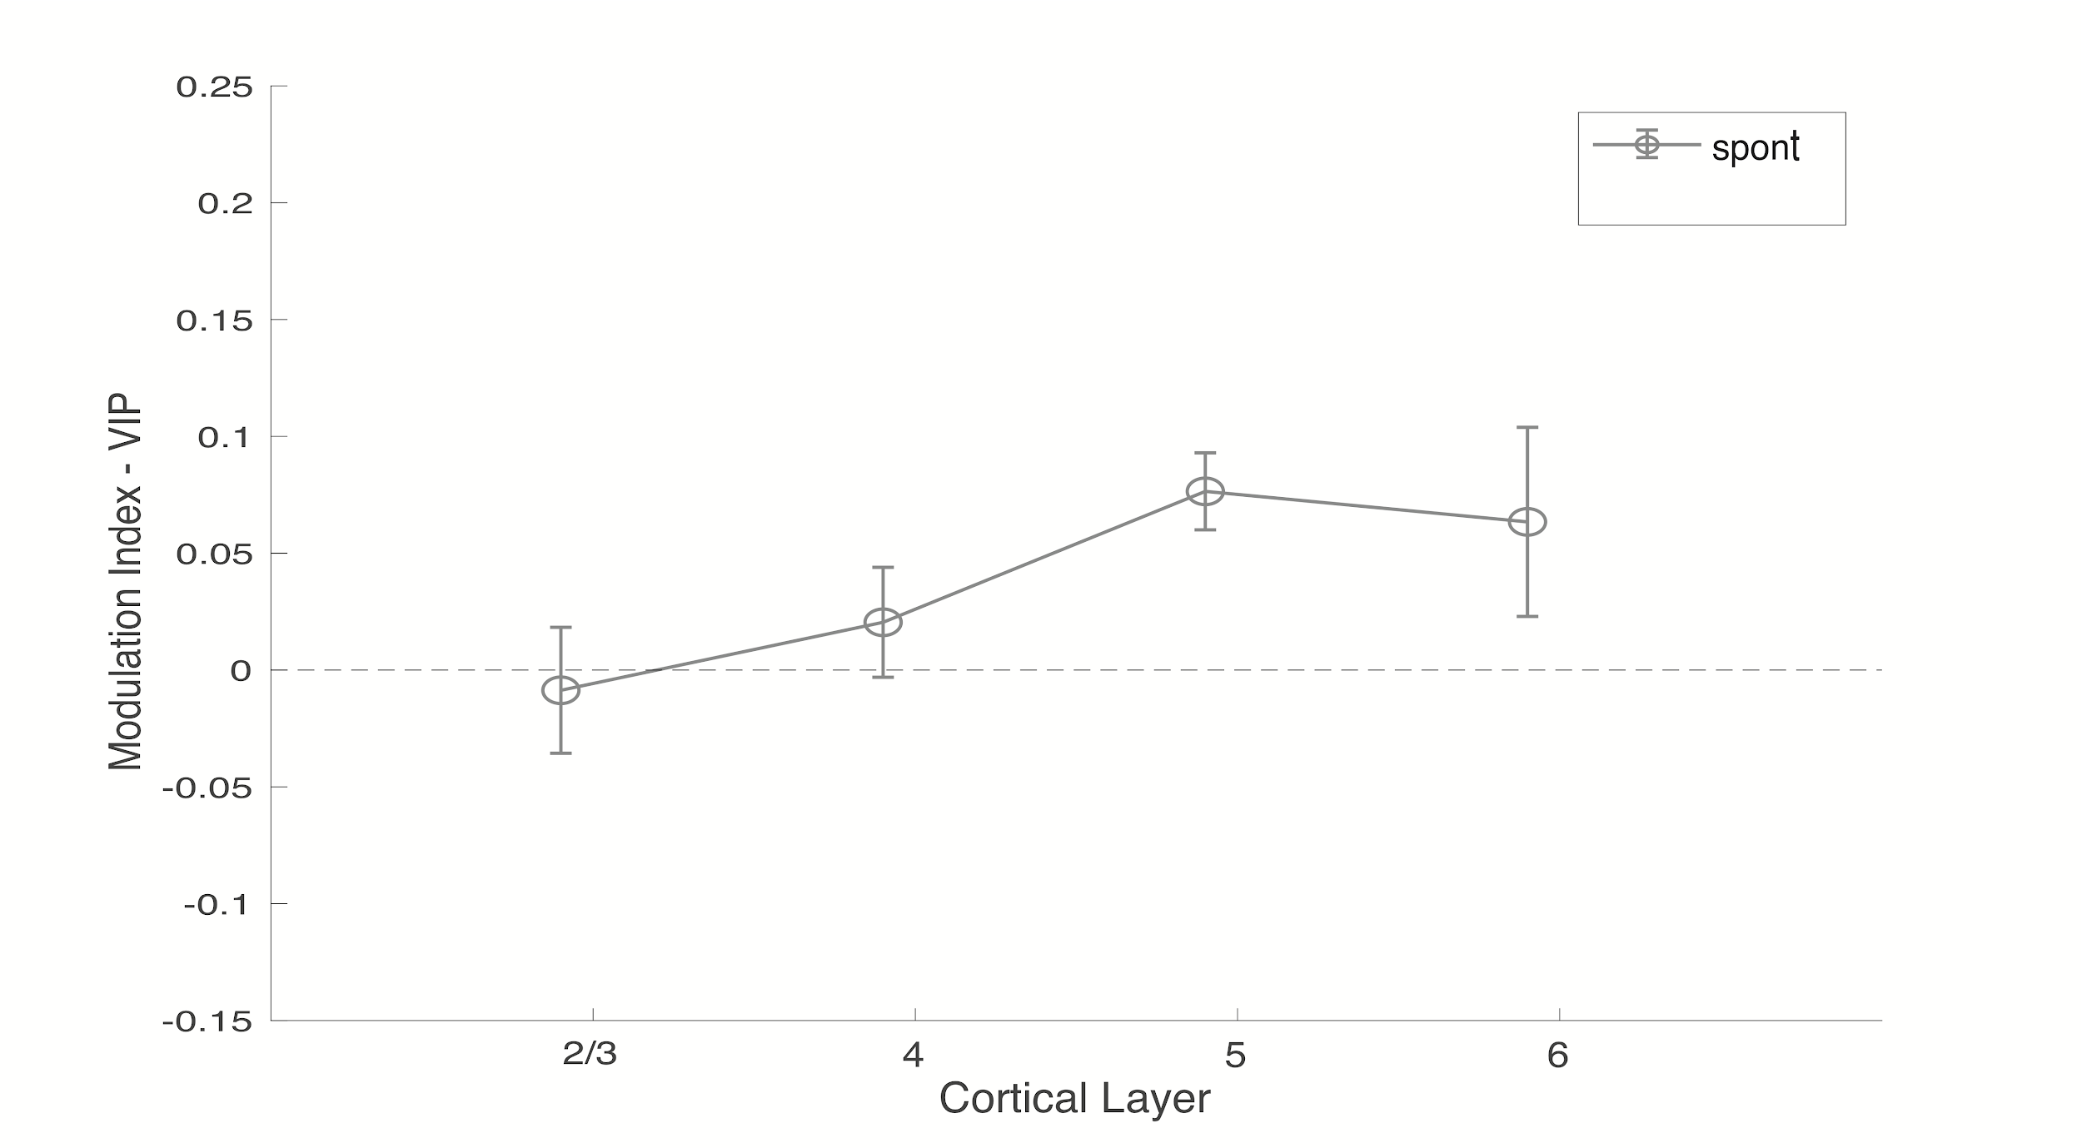
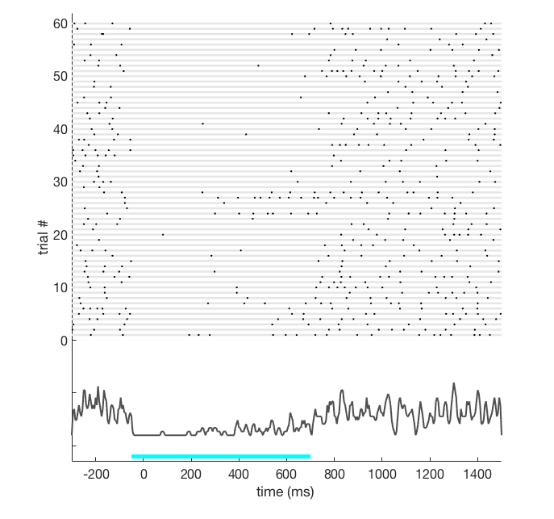
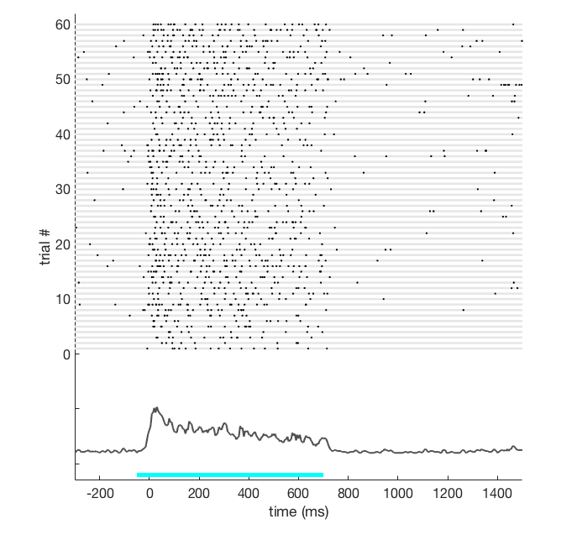
VIP activation - spontaneous
Laser ON

Slide 27
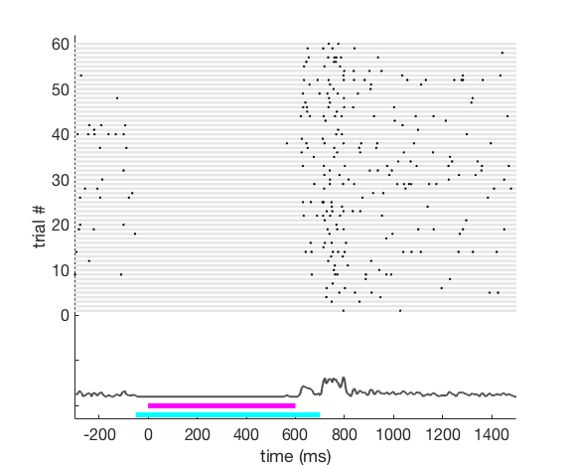
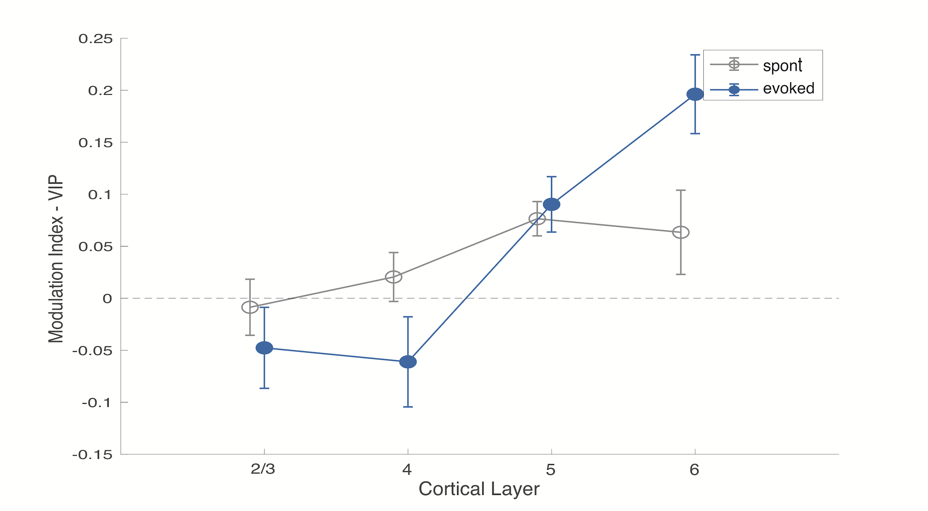
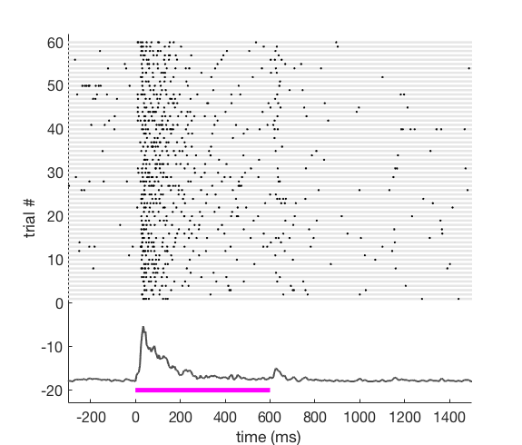
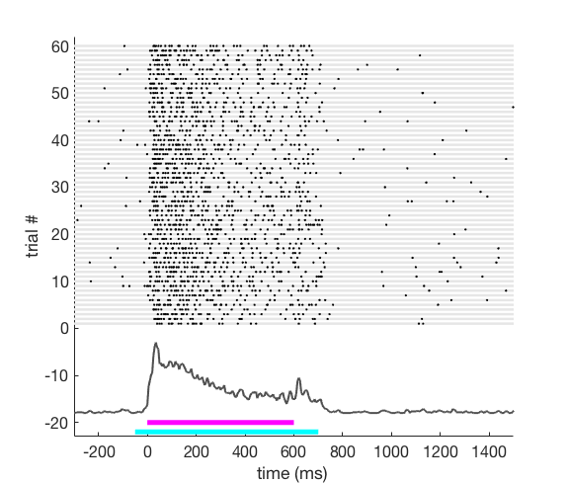
VIP activation - evoked
Laser OFF
Laser ON
L4
L6
Notes:
effects are even stronger in the infragranular layers

Slide 28
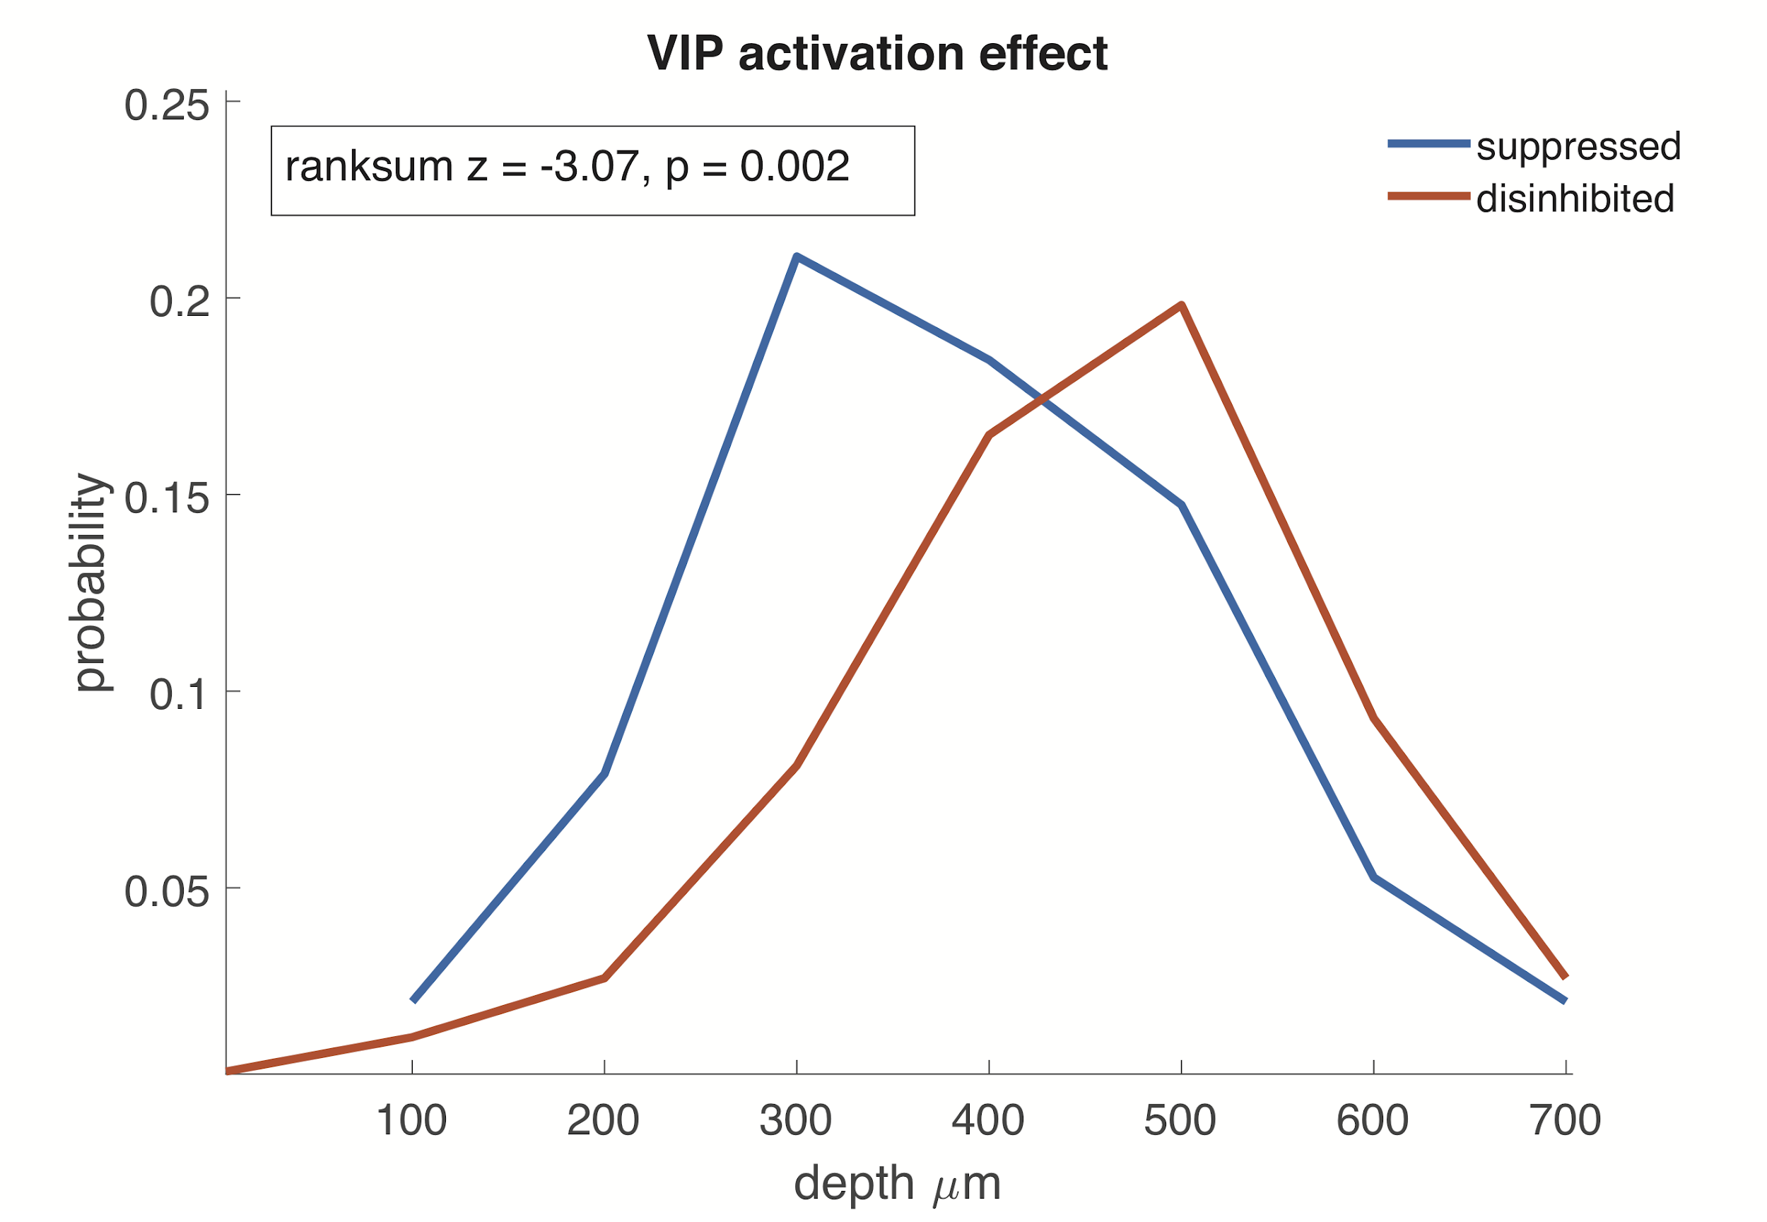
VIP activation - evoked
Laser OFF
Laser ON
L4
L6

Slide 29
Modulation by VIP - Summary
VIP activation produces diverse distributed effects on all cortical neurons
Overall, VIP activation leads to disinhibition of spontaneous and evoked activity
The strongest disinhibitory effect is seen in infragranular layers

Slide 30
Outline
Locomotion
Effects of behavioral state change on neural activity
VIP
Effects of VIP activation on neural activity
SOM
PV
Interaction between behavioral and VIP modulation of neural activity
Exc
Notes:
Mike suggests you could point out the A, B, A*B logic here

Slide 31
Modulation Index - VIP
Modulation Index - Running
Notes:
if running is mediated by VIP network you would expect there to be a relationship between two effects

Slide 32
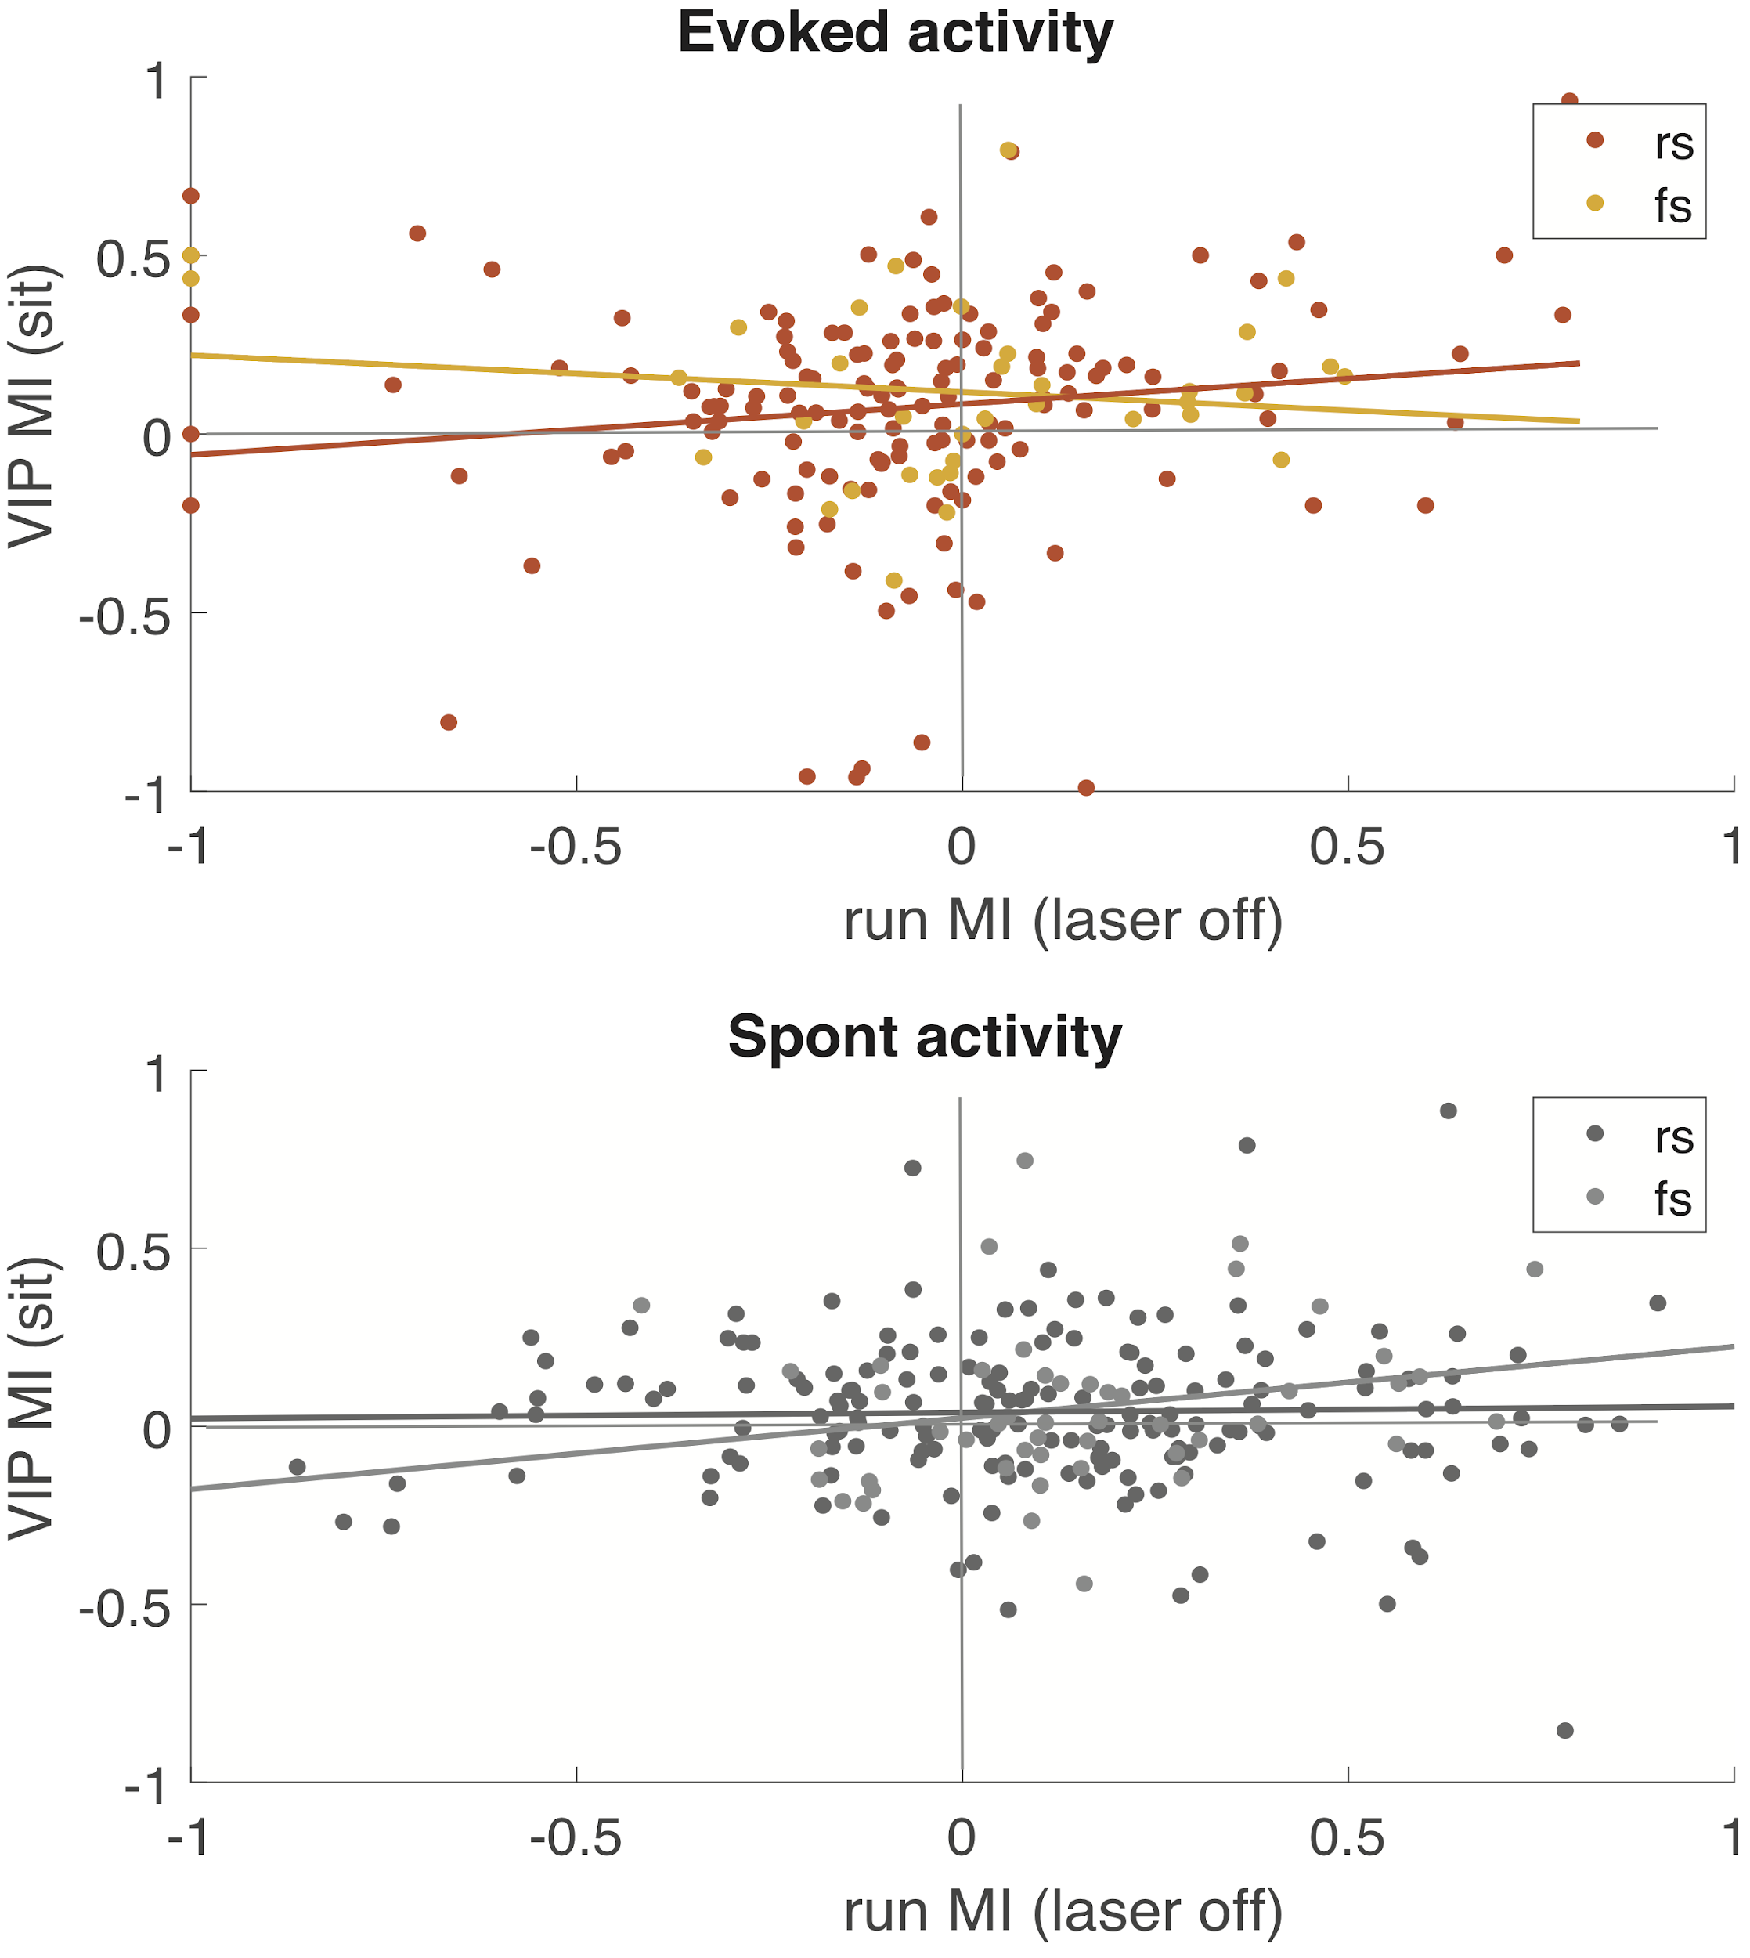
Is running effect mediated by VIP interneurons?
rs rho = 0.17, p = 0.01
fs rho = 0.13, p = 0.34
rs rho = -0.01, p = 0.81
fs rho = 0.25, p = 0.06

Slide 33
Test for interaction
neuron
VIP
+
=
Locomotion
Variable A
Variable B
A + B
running
VIP
running + VIP
Additive effect
Notes:
Try a “circuit diagram” for slide 33 (parallel) & 34 (serial)

Slide 34
Test for interaction
neuron
VIP
Variable A
+
Variable B
=
A + B
running
VIP
running + VIP
Locomotion
Sublinear effect
Notes:
Add a diagram of cells and effects

Slide 35
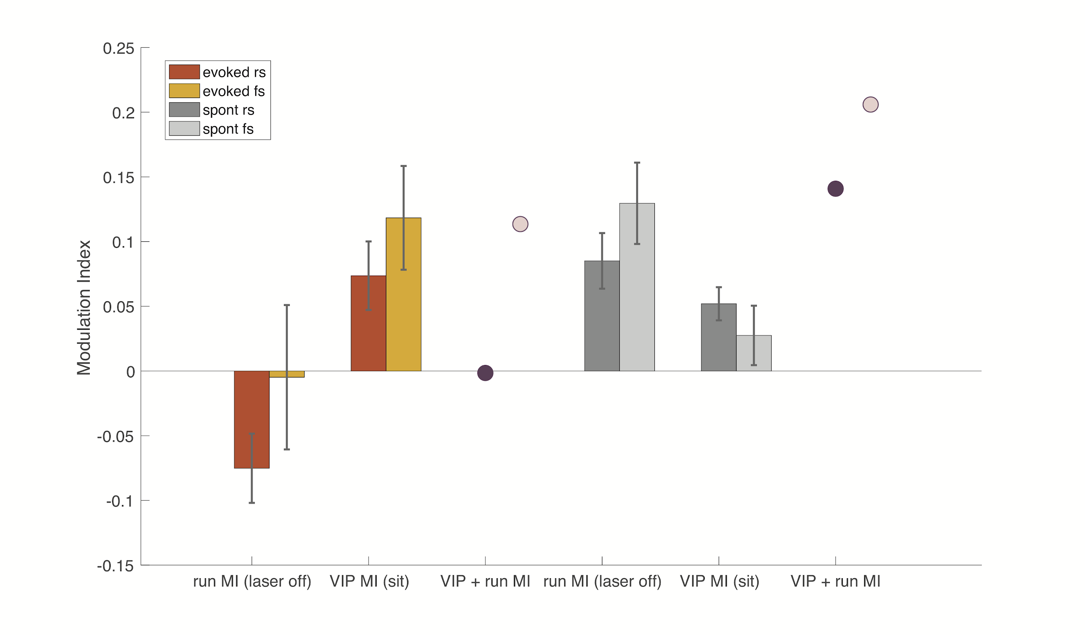
Test for interaction

Slide 36
Test for interaction

Slide 37
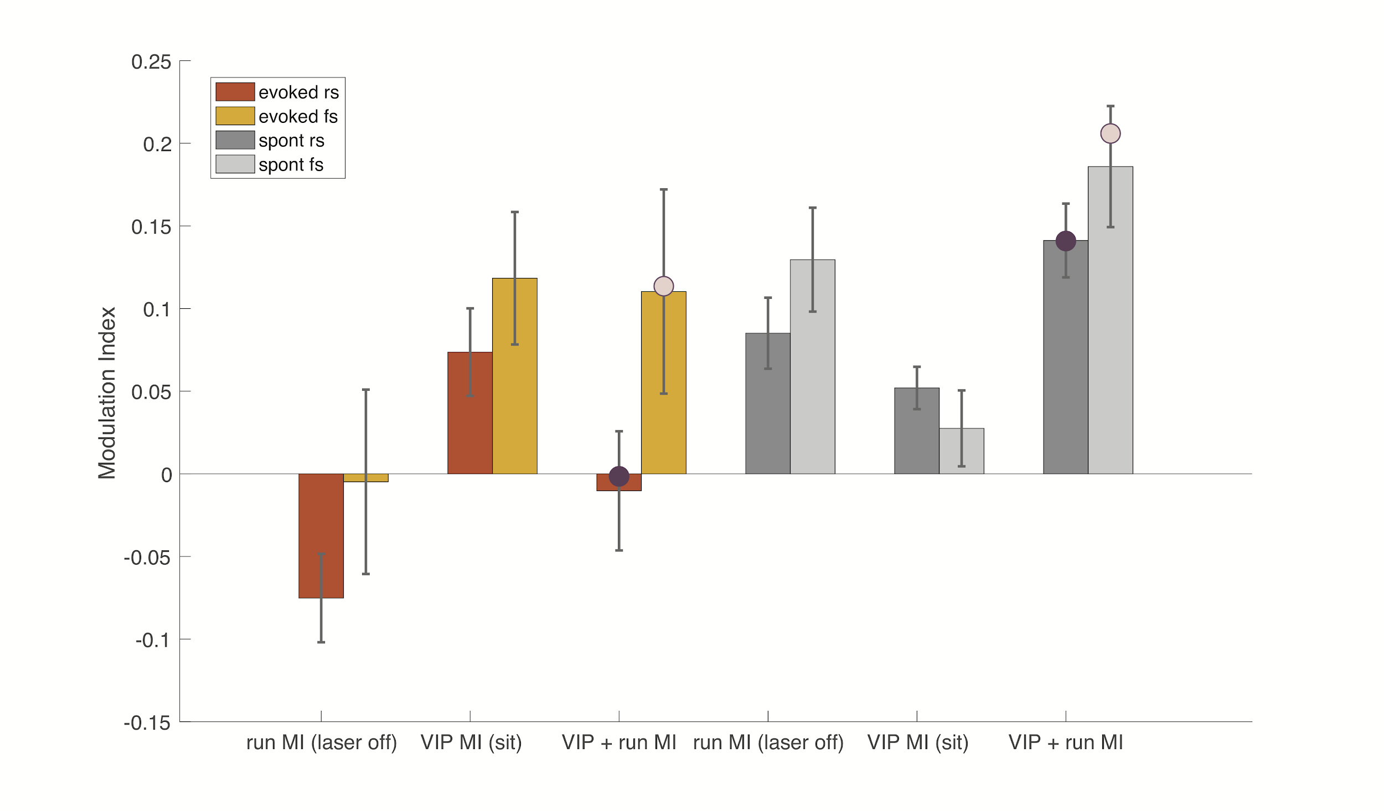
Test for interaction
Notes:
Well predicted

Slide 38
Test for interaction
Notes:
Well predicted

Slide 39
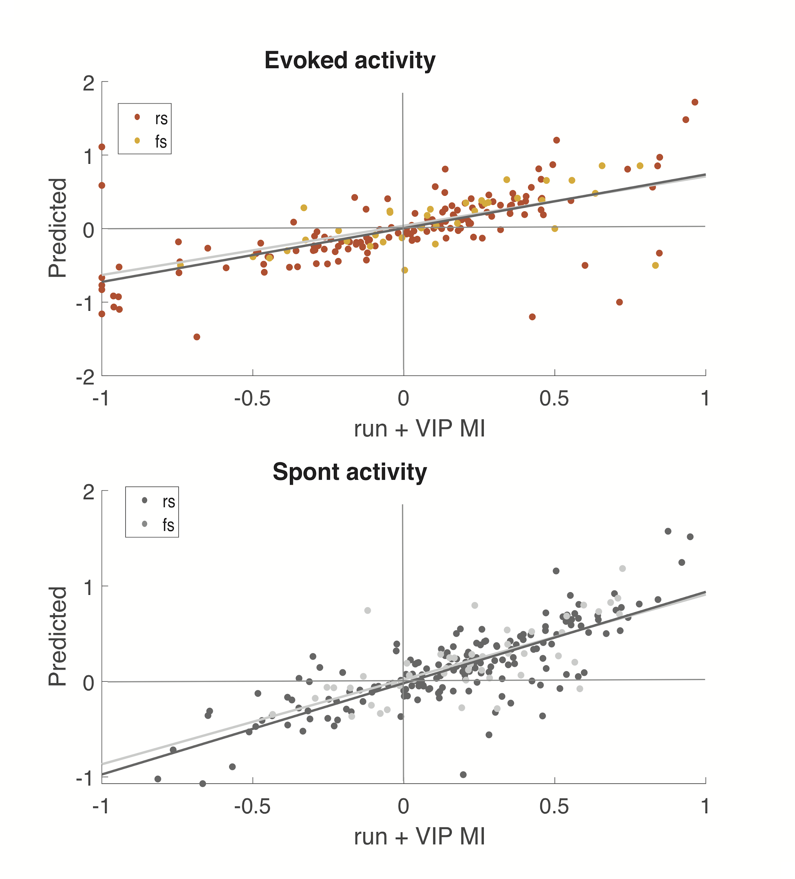
Test for interaction
y = -0.01 + 0.80x
y = -0.001 + 0.92x
rho = 0.71, p = 7.03e-32, n = 216
rho = 0.71, p = 5.41e-43, n = 313
Notes:
statistics

Slide 40
Summary
Changes in behavioral state have diverse and distributed effects on auditory cortical neurons
Activity of VIP interneurons can lead to both suppression or disinhibition of auditory cortical neurons
VIP can strongly disinhibit infragranular cortical layers
Endogenous modulation of cortical activity by running (and arousal) is most definitely probably not mediated by VIP network.

Slide 41
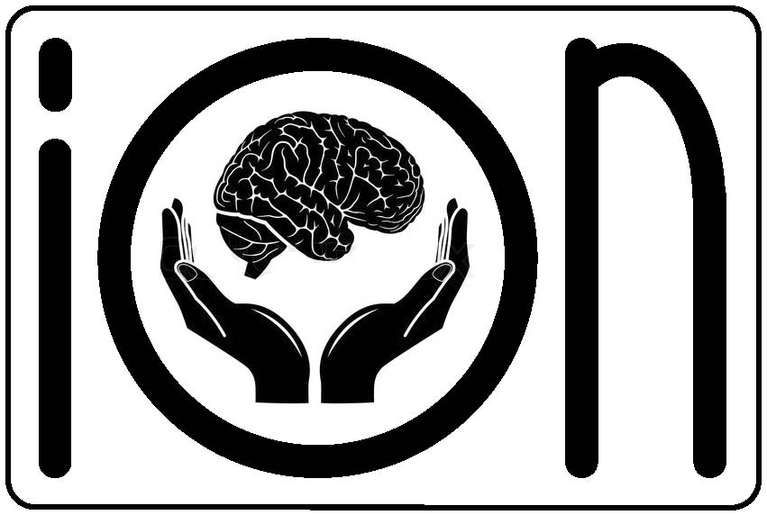
Acknowledgements
Wehr lab
Mike Wehr
Aldis Weible
Jonny Saunders
Allie Moore
Michael Kyweriga
Taryn Gillies
Lucas Ott
Kip Keller
Nick Sattler
Committee
Mike Wehr
Matt Smear
Cris Niell
Paul Dassonville
Psychology department
Lori Olsen !
Animal Facility Staff
+
+
ION
Mindy Kirk

Slide 42
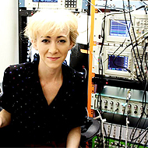
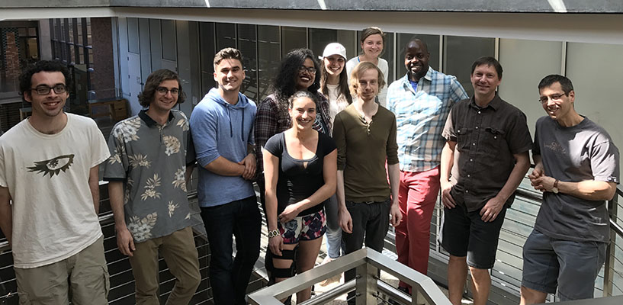


Acknowledgements - Wehr-dos!

Slide 43
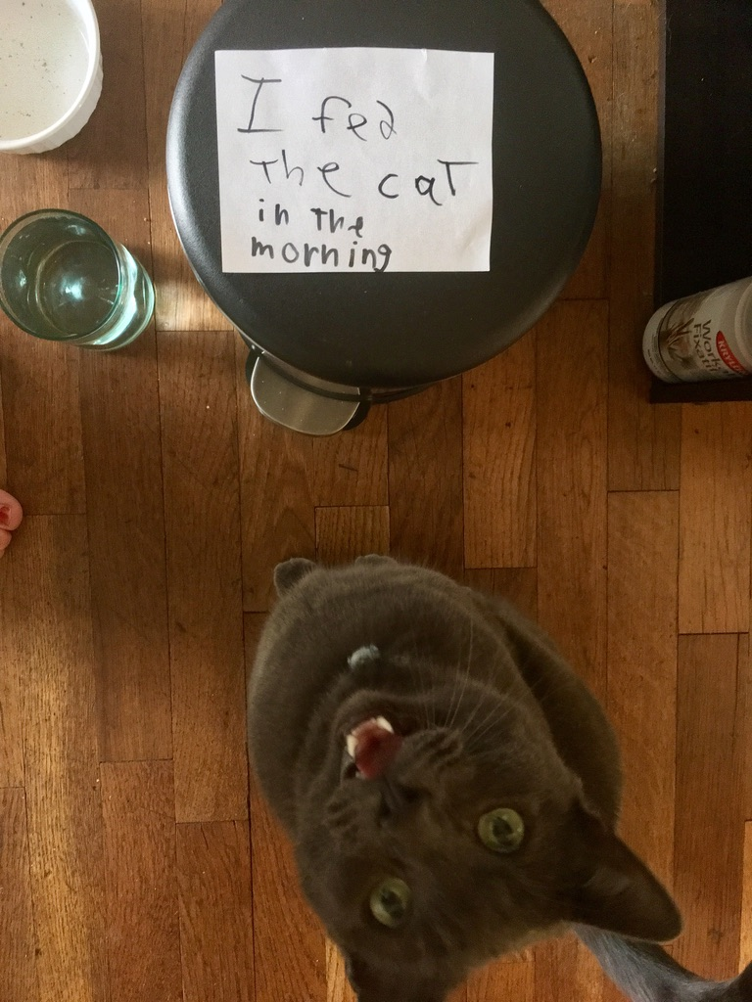







Acknowledgements – Eugene friends!
Notes:
Support in the messages I received in the past few days

Slide 44


Acknowledgements – family!
Notes:
Unconditional love and dealing with a cranky child

Slide 45




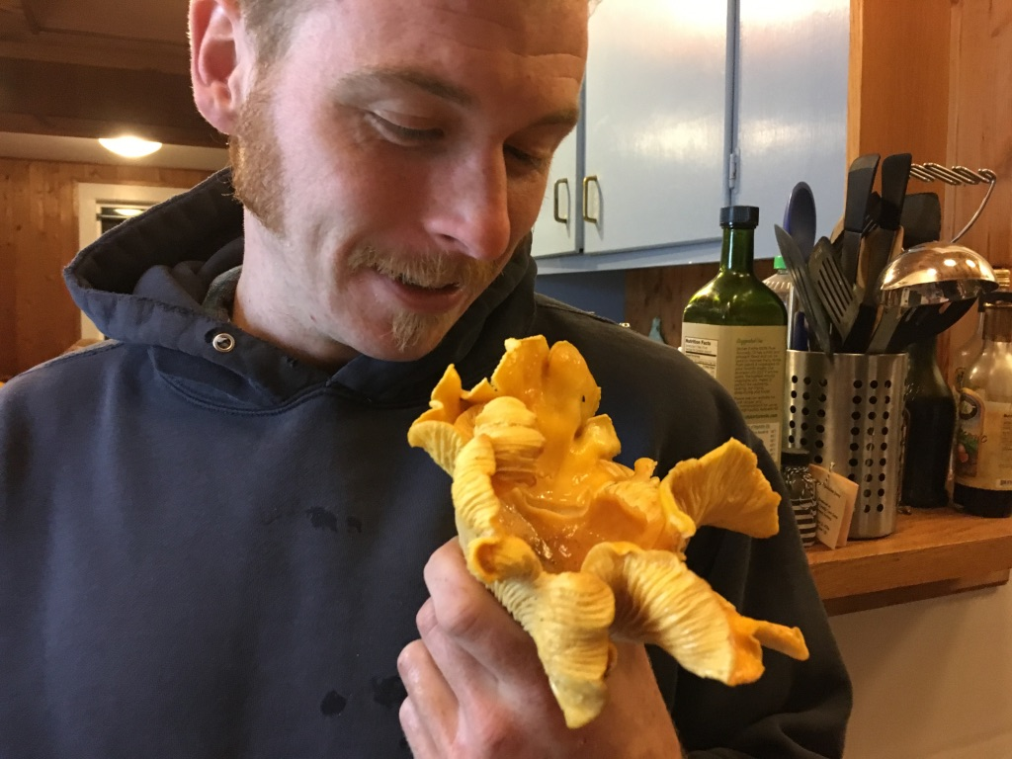


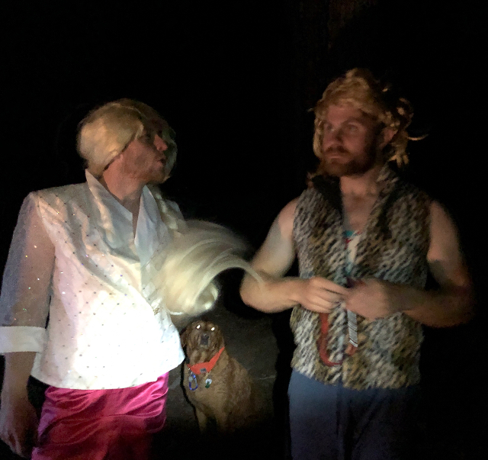
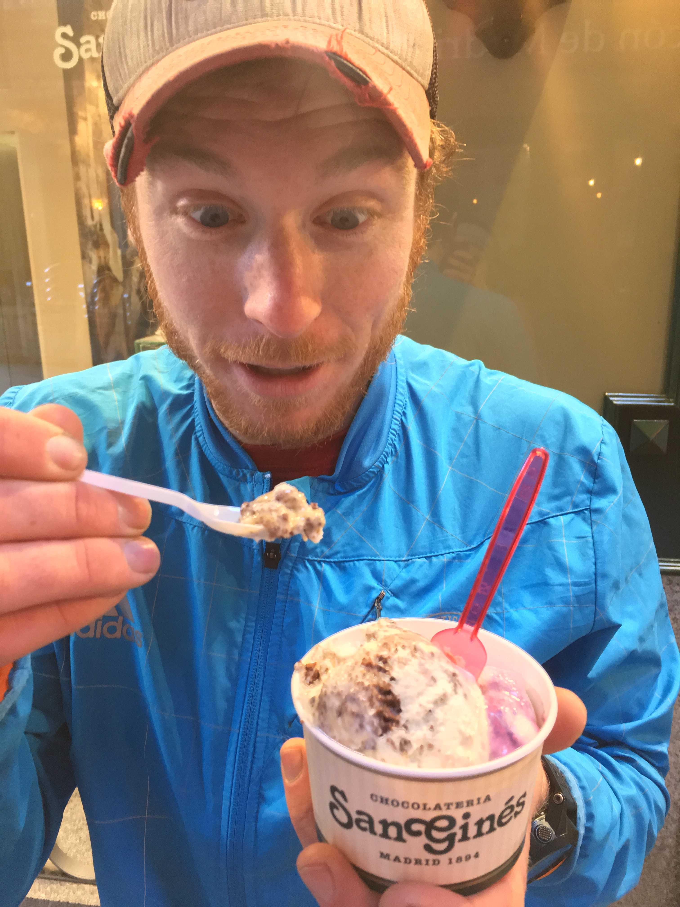
Acknowledgements – Andrew!

Slide 46

Questions

Slide 47
Extra slides

Slide 48



Distribution of responses by cortical layer

Slide 49






Experimental Design
Firing rate (Hz)
Pupil size (a.u.)
Running speed (cm/s)
1 min

Slide 50


Slide 51

Types of responses - running

Slide 52

Modulation of regular and fast spiking neurons - running

Slide 53

Signal to noise ratio - running

Slide 54

Modulation of On and Off responses
ON
OFF

Slide 55

VIP activation is similar across all states

Slide 56

Arousal

Slide 57

Behavioral modulation does not change during VIP laser on trials

Slide 58

VIP activation across cortical layers

Slide 59

SOM suppression

Slide 60


Slide 61

Things we know about VIP neurons in Auditory Cortex
They are very sparse, most dense in L 2/3 (60%)
Express nACh receptors
Regular waveform, low FR, long latency (~30 ms)
Inhibit SOM strongly, PV and PNs weakly
Most GABA+ synaptic targets are in deep layers
Mostly target dendrites, but can also make synapses at the soma
100 μm
L6 L5 L4 L2/3 L1
Notes:
VIP interneurons also show diversity in their connectivity and morphology across cortical layers. In layer II/III they typically exhibit bipolar/ bitufted dendritic morphology, while in deeper layers IV-V their shapes expand to other varieties such as tripolar, multipolar, and atypical types (Bayraktar, Welker, Freund, Zilles, & Staiger, 2000; Prönneke et al., 2015). VIP neurons in superficial layers tend to send their axons to all layers in columnar fashion while keeping their dendrites in layers I and II/III. On the other hand, VIP cells in layers IV-V restrict their axons to deeper layers while spreading dendrites across all cortical column, suggesting that effects of VIP activation may not only be specific to their column but also to their layer.

Slide 62


Slide 63


Individual variability in strength of modulation

